Slide 1




January 12-15th, 2012, Whistler Olympic Park
TEAM CAPTAINS MEETING
INTERVAL START
JANUARY 15, 2012
Notes:
Add ccbc and ccc logos
Do wash of presenting sponsor logo
Make template of slide outline and use for all slides
List venue (WOP)

Slide 2

PRESENTING SPONSOR

Slide 3
AGENDA
Sign In Reminder & DNS
Introduction of the OC and the Jury
Entries and Draw
Venue Overview
Timetable
Weather Forecast
Stadium
Courses
Ski testing and Warming Up
Course Preparation and Grooming
Information from the TD and CCC Race Director
Information from the OC

Slide 4
OC:
    Chairman: Len Apedaile
    Chief of Competition: Dirk Rohde
    Race Secretary: Nicola Kilfoy
    Chief of Timing: Denis Brown
    Chief of Course: Chuck Beebe
    Chief of Stadium: Delores Franz Los
    Chief of Control: Jamie Stirling
    Venue Services: John Heilig
JURY:
    TD: Claude Chabot
    TD assistant: Dan Brisbin
    CCC Race Director: Dave Dyer
    Chief of Competition: Dirk Rohde
Notes:
Update list of people – include Heilig as Venue Services

Slide 5
ENTRIES AND DRAW
Verification of entries and points
Draw

Slide 6
VENUE OVERVIEW
Notes:
Len to send mo an overview map
Only at first TCM

Slide 7
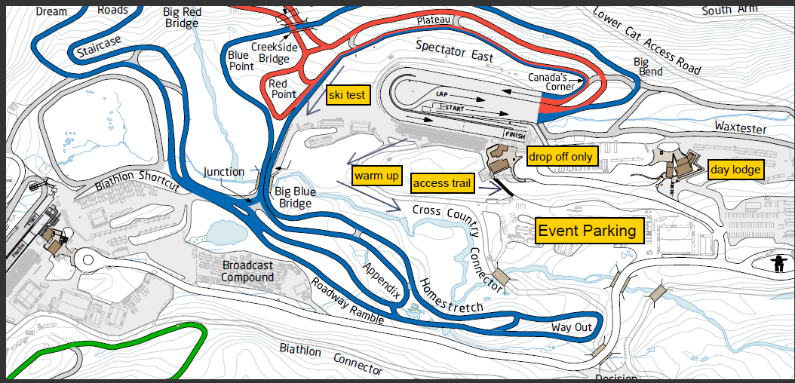

Slide 8
Time | Activity
7:00 | Gate Opens
8:00 | Race Office Open
8:30 | Bib Distribution, Course open for Training
10:00 | Open/Jr Men 15km
11:15 | NorAm Awards
11:30 | Open/Jr Women 10km
1:15 | NorAm Awards
1:30 | BC Cup #1 – Interval Start, Classic
3:00 | BC Cup #1 - Awards
TIMETABLE
NorAm
Notes:
Use excel spreadsheet from master schedule – only key times that athletes need to know

Slide 9
WEATHER FORECAST

Slide 10
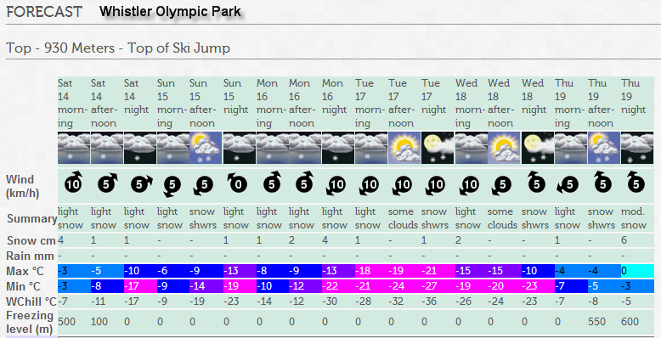

Slide 11
WEATHER FORECAST
http://www.whistlerblackcomb.com/weather/forecast
http://www.weatheroffice.gc.ca/forecast
http://www.whistlerolympicpark.com/weather
Notes:
Len to provide narrative, Use environment canada forecasts and whistler blackcomb provide links

Slide 12
STADIUM
Notes:
Len to give to mo

Slide 13
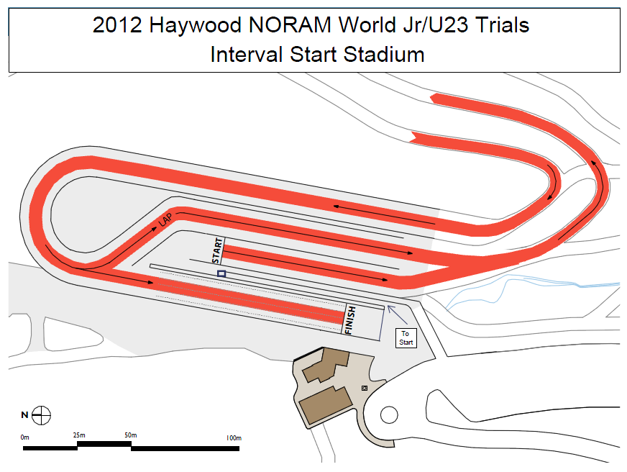

Slide 14
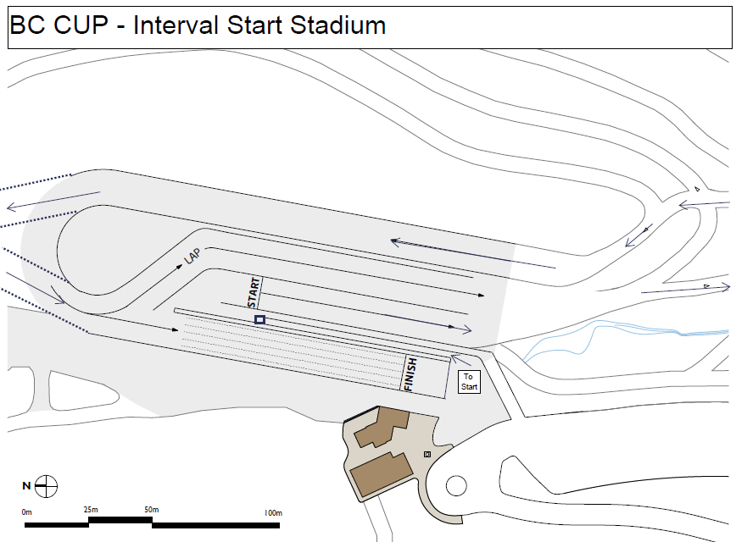

Slide 15
Course Maps
Notes:
Insert course map, use blank slide for map if too squeezed

Slide 16
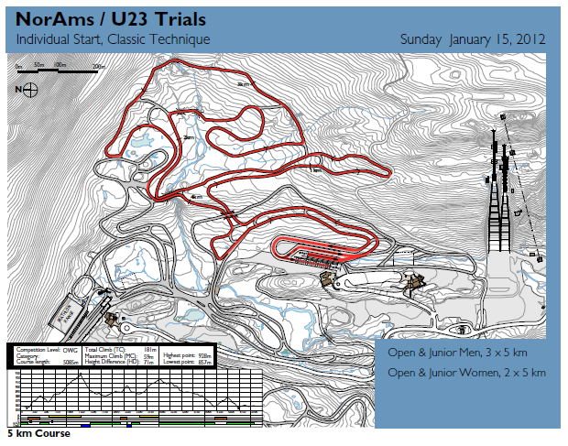

Slide 17
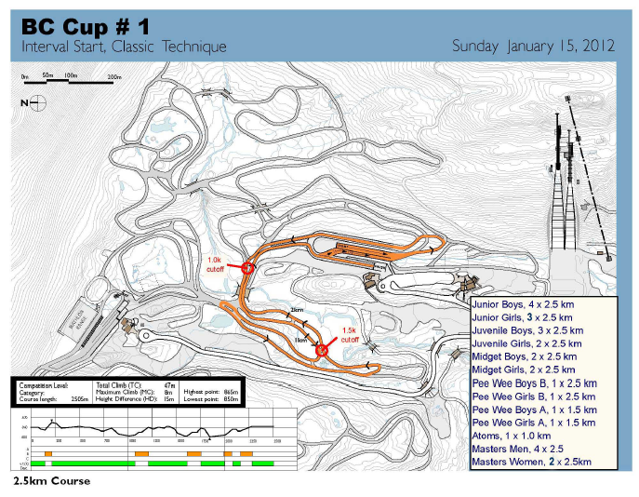

Slide 18
SKI TESTING AND WARMING UP
Wax testing locations
  Warm-up area
  Ski test area
  Testing on course after men finished
  Upper trail to jump & back over bridge
No testing equipment on course
Testing in direction of travel on race course
Notes:
Need specific info from TD

Slide 19
COURSE PREPARATION AND GROOMING
  Schedule for grooming – after 4:00 p.m.
  2 tracks – Red 5 km NorAm course
  4 tracks – BC Cup course
  Interval start
    NorAms – 30 seconds
    BC Cup – 15 seconds
Notes:
Don’t forget to ask to the Team Captains if they have any comments concerning the course, track setting, course preparation…

Slide 20
GENERAL INFORMATION FROM THE TD/RD
General comments from Technical Delegate
General comments from Race Director

Slide 21
GENERAL INFORMATION FROM THE OC
Venue access
  Until 11:00 p.m.
  Contact John @ 604-966-4258
Egress
  Return wax cabin keys
  Access from upper lot
Thanks!

Slide 22



















Notes:
List of all logos

