Slide 1




January 12-15th, 2012, Whistler Olympic Park
TEAM CAPTAINS MEETING
SPRINTS
JANUARY 14, 2012
Notes:
Add ccbc and ccc logos
Do wash of presenting sponsor logo
Make template of slide outline and use for all slides
List venue (WOP)

Slide 2

PRESENTING SPONSOR

Slide 3
AGENDA
Sign In Reminder & DNS
Introduction of the OC and the Jury
Event Program
Entries and Draw
Venue Overview
Timetable
Weather Forecast
Stadium
Courses
Ski testing and Warming Up
Course Preparation and Grooming
Information from the TD and CCC Race Director
Information from the OC

Slide 4
OC:
    Chairman: Len Apedaile
    Chief of Competition: Dirk Rohde
    Race Secretary: Nicola Kilfoy
    Chief of Timing: Denis Brown
    Chief of Course: Chuck Beebe
    Chief of Stadium: Delores Franz Los
    Chief of Control: Jamie Stirling
    Venue Services: John Heilig
JURY:
    TD: Claude Chabot
    TD assistant: Dan Brisbin
    CCC Race Director: Dave Dyer
    CCC Representative: James Cunningham
    Chief of Competition: Dirk Rohde
Notes:
Update list of people – include Heilig as Venue Services

Slide 5
EVENT PROGRAM
  Competitions and Training
  Team Captains’ Meetings
  Official Awards Ceremonies
Notes:
Mention Sheet with Schedule at Back

Slide 6
ENTRIES AND DRAW
Verification of entries and points
Draw

Slide 7
VENUE OVERVIEW
Notes:
Len to send mo an overview map
Only at first TCM

Slide 8
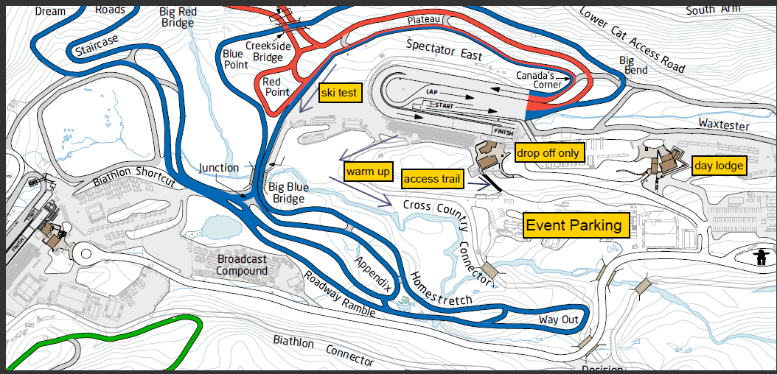

Slide 9
TIMETABLE
Time | Activity
6:30 | Gate Opens
7:00 | Race Office Open
8:00 | Bib Distribution, Course open for Training
9:00; 9:45 | Sprint Qualifications – Women; Men
11:00; 12:05 | Sprint Heats – Jr/Sr Women; Jr/Sr Men
1:30 | NorAm Teck Sprint Awards
2:00 | BC Cup #1 – Mass Start , Free
2:35 | BC Cup #1 – Awards for Atoms, Pee Wees
3:30 | BC Cup #1 – Awards for Midget, Juvenile
3:45 | BC Cup #1 – Awards for Juniors, Masters
Notes:
Use excel spreadsheet from master schedule – only key times that athletes need to know

Slide 10
WEATHER FORECAST

Slide 11
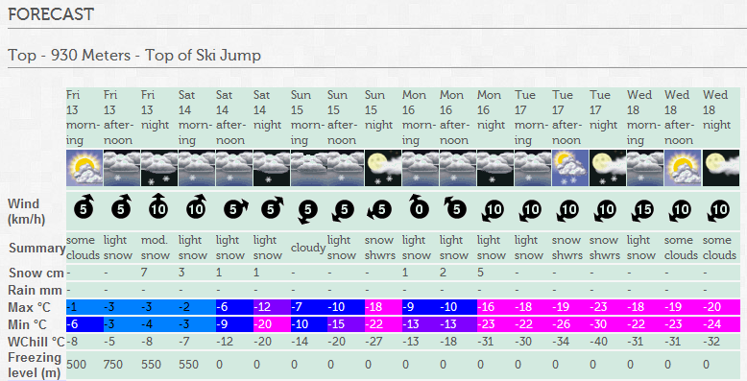

Slide 12
WEATHER FORECAST
http://www.whistlerblackcomb.com/weather/forecast
http://www.weatheroffice.gc.ca/forecast
http://www.whistlerolympicpark.com/weather
Notes:
Len to provide narrative, Use environment canada forecasts and whistler blackcomb provide links

Slide 13
STADIUM
Notes:
Len to give to mo

Slide 14
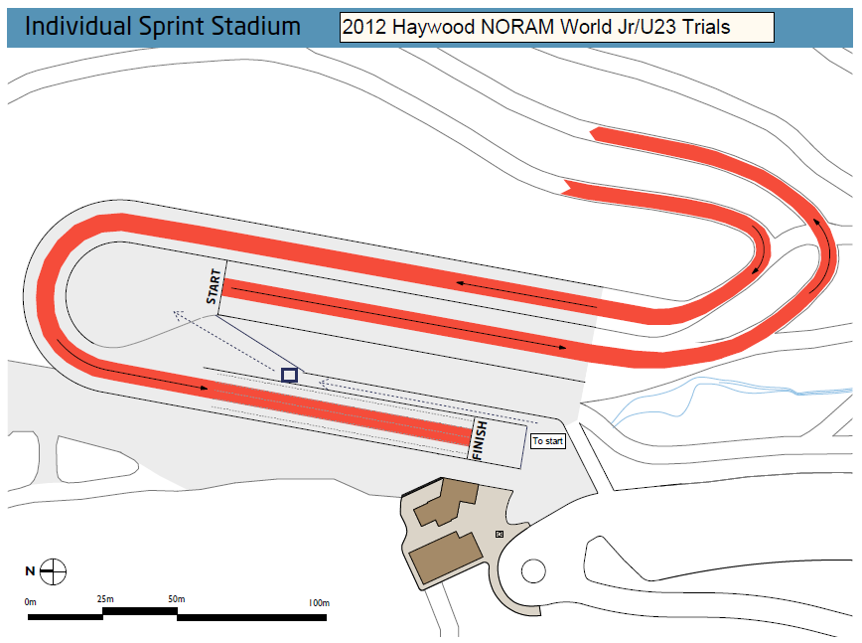

Slide 15
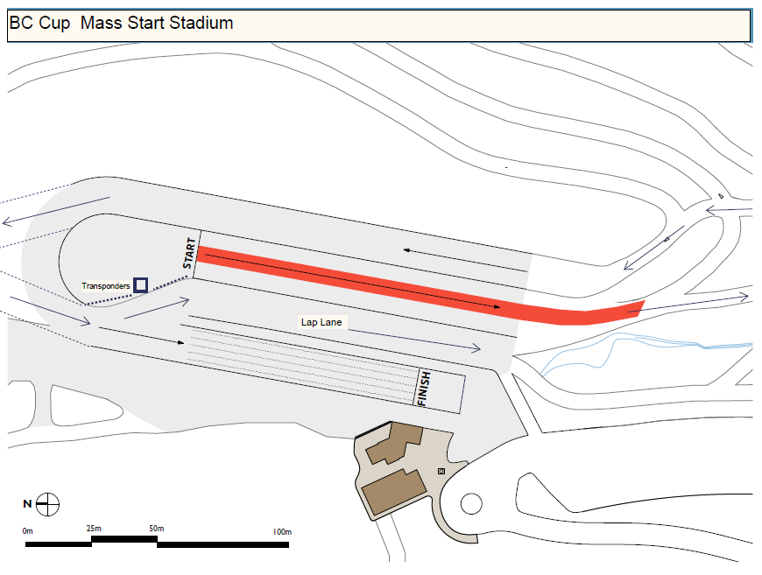

Slide 16
Course Maps
Notes:
Insert course map, use blank slide for map if too squeezed

Slide 17
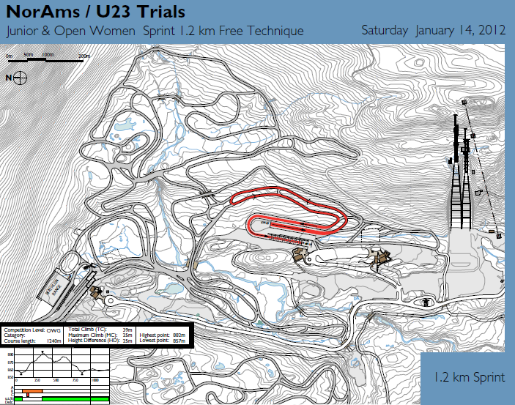

Slide 18
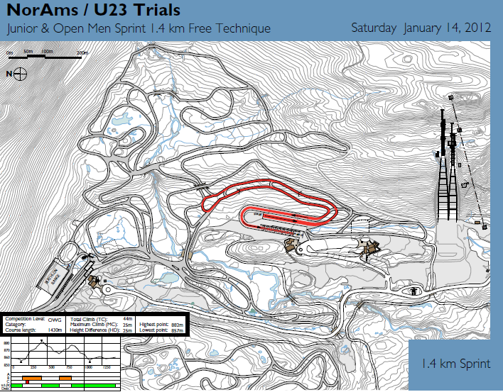

Slide 19
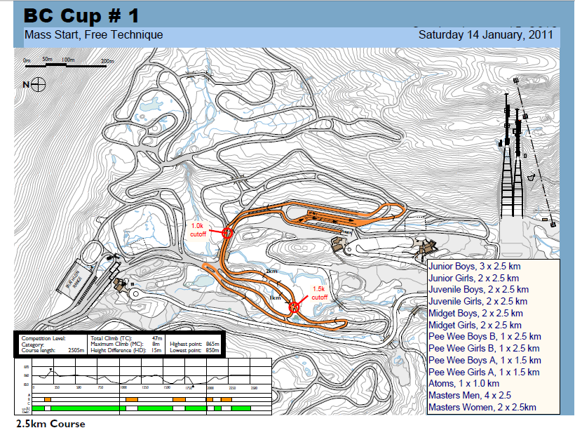

Slide 20
SKI TESTING AND WARMING UP
Wax testing locations
  Warm-up area
  Ski test area
Warm-up/Cool-down
  Warm-up area
  Upper trails
  Try to stay off BC Cup course
Notes:
Need specific info from TD

Slide 21
COURSE PREPARATION AND GROOMING
  Schedule for grooming – after 4:00 p.m.
  7 start tracks – 1 qualification, 6 heats
  Portable toilets
Notes:
Don’t forget to ask to the Team Captains if they have any comments concerning the course, track setting, course preparation…

Slide 22
SPRINT PROTOCOL
  Standard FIS sprint protocol
  Top 30 qualifiers advance per category
  15 second interval starts
  B final
  Timed heats
    “Lucky loser” based on best time in heats (not qualifier)
    Lane choice by heat position, qualifying time (360.3.3)
  Leg bibs required for heats
  TV monitor in breezeway for heat advancement
Notes:
Don’t forget to ask to the Team Captains if they have any comments concerning the course, track setting, course preparation…

Slide 23
GENERAL INFORMATION FROM THE TD/RD
General comments from Technical Delegate
General comments from Race Director

Slide 24
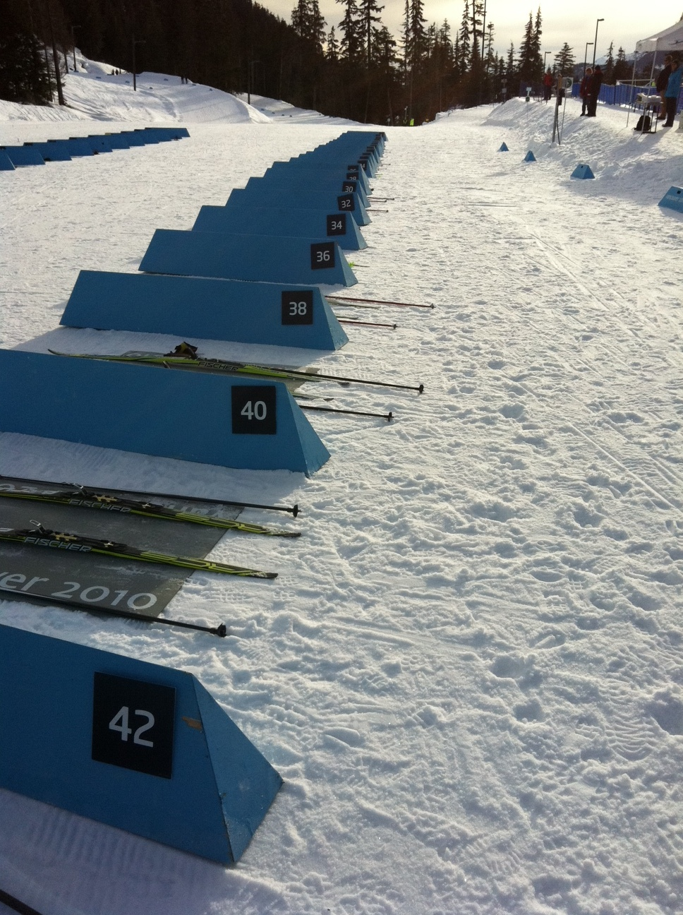
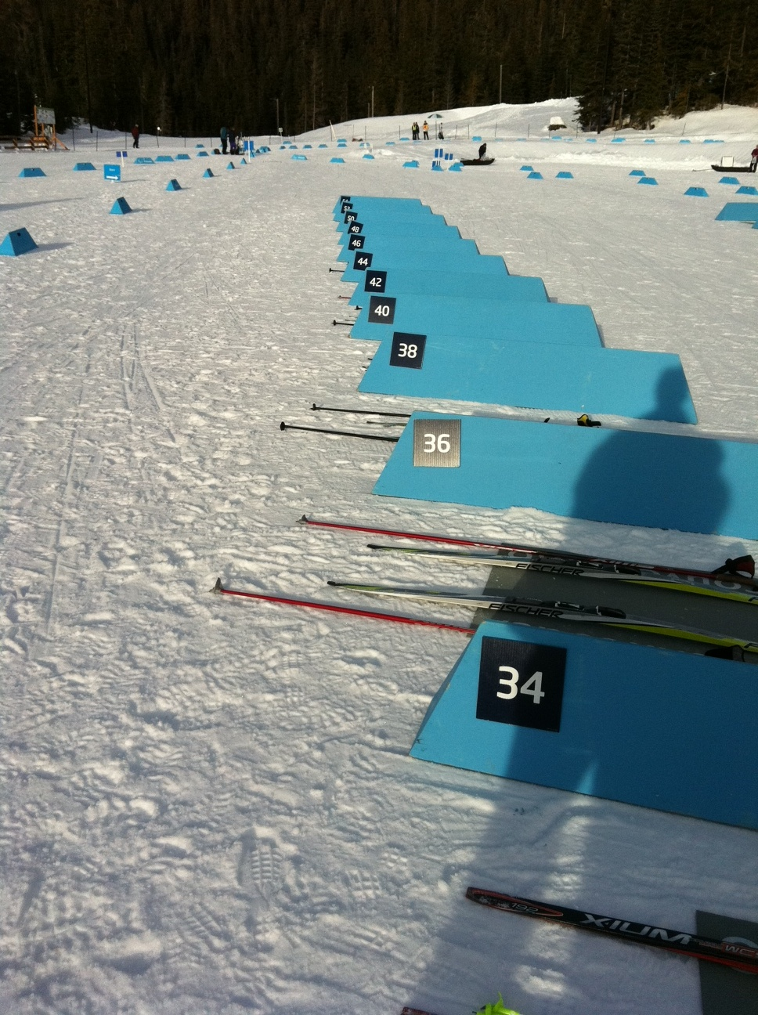

Slide 25
GENERAL INFORMATION FROM THE OC
Venue access
Venue hours
Food and warmth
Internet Access – User: guest; Password: password
Questions?

Slide 26



















Notes:
List of all logos

